Slide 1
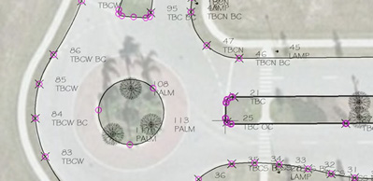



“Field to Finish”
Working with AutoCAD Civil 3D
Shawn Herring
Civil Applications Engineer @ ProSoft, Inc
Training & Support Manager

Slide 2

Introduction:
Shawn Herring
    9 years in Civil Engineering Community
    Drafter/Designer
    CADD Manger
    Project Manager
    Civil Engineer
    3+ Years with Autodesk Reseller
    Teach and Support Civil 3D, Map 3D, SSA and AutoCAD
    Civil 3D Certified Professional Since 2007
    Speak at numerous User Groups across the country
    Manage Support/Training Staff
    Multiple Social Media Sites
Jason Jenkins, PLS
Jason is a Professional Land Surveyor, Licensed in the State of Utah. He has 19 years’ experience in surveying and land planning, with a strong background in Civil Engineering. He was the Chief Designer and CAD Manager for an engineering firm for 9 years and has owned his own surveying firm for the last 10 years. Jason is the most recent addition to the ProSoft staff and will be a valuable asset to the civil engineering and surveying community.

Slide 3

▪ Follow us on any of these media sites ▪
Facebook – ProSoft
Twitter - @ProSoft_AEC
YouTube – ProSoftCAD http://www.youtube.com/user/ProSoftCAD
LinkedIn
Blog – ProSoftAEC http://prosoftaec.blogspot.com/

Slide 4
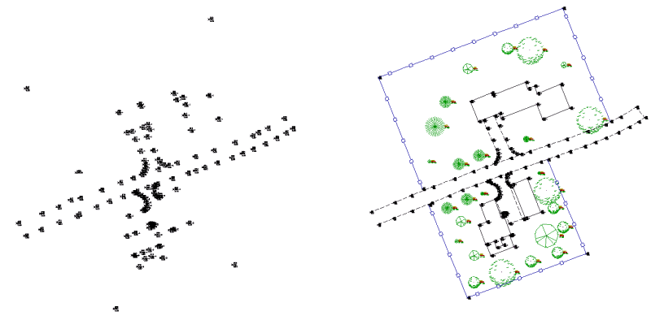
Agenda
“Field to Finish”
Figure Prefix Database
Linework Code Set
Data Collection
Editing Survey Figures
Bonus Information
Questions

Slide 5
Agenda
2:15 – 3:30 (Field)
Overview of Field Collection
Survey Parking Lot!!
3:30 – 4:00
Break
4:00 – 5:30 (Finish)
Create Civil 3D Setup
Import Database
Inspect and Finish!!

Slide 6
Goals:
At the end of today’s session…
Learn the components and procedures required to collect linework in the field.
Witness a workflow that will work with any survey data collection equipment.
Learn how to quickly and easily edit survey figures
Understand the business benefits of collecting field data in a way that line work is created automatically.
Let’s Get Started….

Slide 7
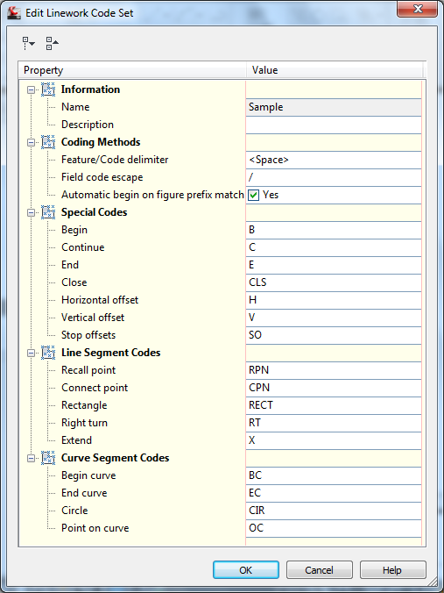
Linework Code Set
Coding Method
  Before or After
  Point Description
Ex: B TBC
  TBC B

Slide 8
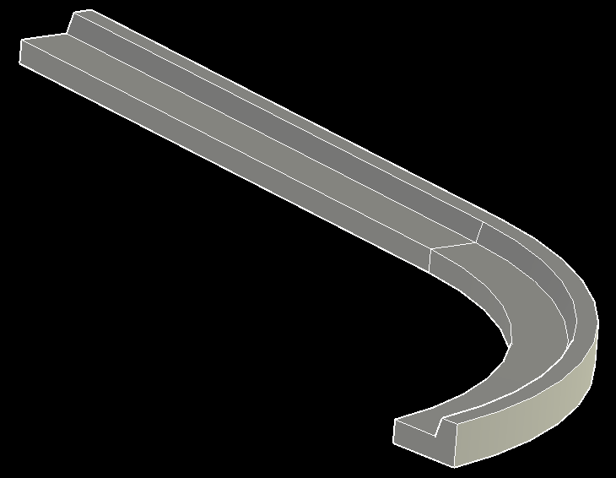
Linework Code Set
  Special Codes (Most Used)
  Begin and End linework
  Start and Stop Horizontal and Vertical Offsets

Slide 9
Linework Code Set
  Line Segment Instructions

Slide 10
Linework Code Set
  Curve Segment Instructions

Slide 11
Linework Code Set
  Any Code is Customizable!
  Ex: B for Begin
  + for Begin
  E for End
  - For End
Universal Field to Finish

Slide 12
New Linework Code Set – Universal F2F
Lines (figures) are automatically created by connecting point descriptions if a linework code is used.
TBC1 B

Slide 13
New Linework Code Set – Universal F2F
In this example B is added to the descriptions to begin linework (figures).
TBC1 B
CL B

Slide 14
New Linework Code Set – Universal F2F
TBC1 B
CL B
TBC2 B

Slide 15
New Linework Code Set – Universal F2F
TBC1 B
CL B
TBC2 B
TBC2

Slide 16
New Linework Code Set – Universal F2F
TBC1 B
CL B
TBC2 B
TBC2
TBC2
Figures are automatically created by connecting point descriptions if a linework code is used.

Slide 17
New Linework Code Set – Universal F2F
TBC1 B
CL B
TBC2 B
TBC2
CL
TBC2

Slide 18
New Linework Code Set – Universal F2F
TBC1 B
CL B
TBC2 B
TBC2
CL
CL
TBC2

Slide 19
New Linework Code Set – Universal F2F
TBC1 B
CL B
TBC2 B
TBC2
CL
TBC1
TBC2
CL

Slide 20
New Linework Code Set – Universal F2F
TBC1 B
CL B
TBC2 B
TBC2
CL
TBC1
TBC2
CL
TBC1

Slide 21
New Linework Code Set – Universal F2F
TBC1 B
CL B
TBC2 B
TBC2
CL
TBC1
TBC1 E
TBC2
CL
TBC1

Slide 22
New Linework Code Set – Universal F2F
TBC1 B
CL B
TBC2 B
TBC2
CL
TBC1
TBC1 E
TBC2
CL
TBC1

Slide 23
New Linework Code Set – Universal F2F
TBC1 B
CL B
TBC2 B
TBC2
CL
TBC1
TBC1 E
CL E
TBC2
CL
TBC1

Slide 24
New Linework Code Set – Universal F2F
TBC1 B
CL B
TBC2 B
TBC2
CL
TBC1
TBC1 E
CL E
TBC2
CL
TBC1

Slide 25
New Linework Code Set – Universal F2F
TBC1 B
CL B
TBC2 B
TBC2
CL
TBC1
TBC1 E
CL E
TBC2 E
TBC2
CL
TBC1

Slide 26
New Linework Code Set – Universal F2F
TBC1 B
CL B
TBC2 B
TBC2
CL
TBC1
TBC1 E
CL E
TBC2 E
TBC2
CL
TBC1
Three figures were automatically created.

Slide 27
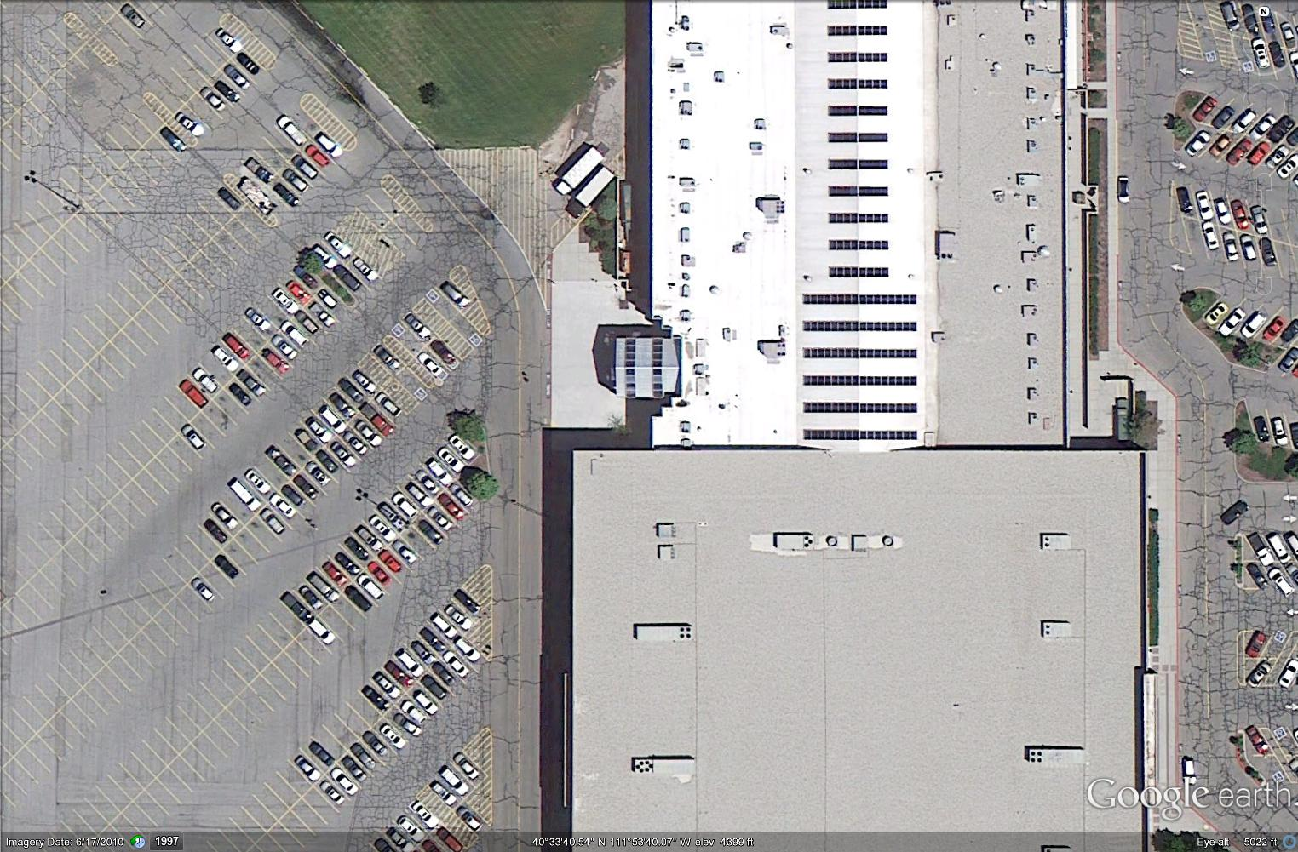
Field Demo – Parking Lot

Slide 28
Demonstration
Linework Code Set
Figure Prefix Database
Setup Civil 3D/Prepare to Import

Slide 29
Linework Code Set
  Any Code is Customizable!
  Ex: B for Begin
  + for Begin
  E for End
  - For End
Universal Field to Finish

Slide 30
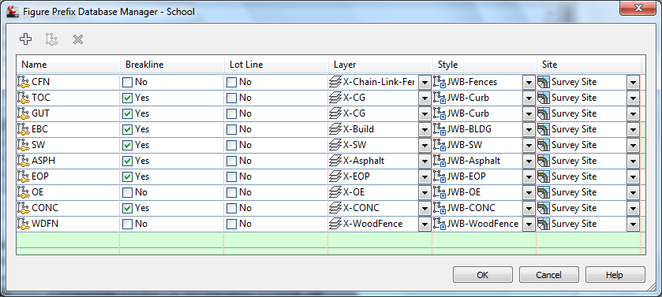
Figure Prefix Database
Figure Prefix
Notes:
Here we’ll see a simple example of a typical project scenario. With the Projects and Data Management solution that Civil 3D offers, a Vault server that can be installed on a network or local machine is where the “project” resides. We have multiple users using multiple drawings accessing and using data in the project.
We have user one who has referenced a surface from the project, and is working with it in a drawing on their machine. At the same time, we have a second user which is also referencing the same surface, but in this case is designing an alignment and profile from it. A third user is accessing the same data, but in this case, they are running an analysis on the surface. Note that these users can have read-write access to the data, allowing for a true multi-user system for sharing and managing our critical project information in real-time.

Slide 31
Demonstration
“FINISH”
Edit and Queries
Surface creation

Slide 32
Survey Database Files:
  Survey Database
  Equipment Database
  Figure Prefix Database
Import Events
Networks
Figures
Survey Points
Equipment
Figure Prefix
Notes:
Here we’ll see a simple example of a typical project scenario. With the Projects and Data Management solution that Civil 3D offers, a Vault server that can be installed on a network or local machine is where the “project” resides. We have multiple users using multiple drawings accessing and using data in the project.
We have user one who has referenced a surface from the project, and is working with it in a drawing on their machine. At the same time, we have a second user which is also referencing the same surface, but in this case is designing an alignment and profile from it. A third user is accessing the same data, but in this case, they are running an analysis on the surface. Note that these users can have read-write access to the data, allowing for a true multi-user system for sharing and managing our critical project information in real-time.

Slide 33
Survey Database:
Import Events
Networks
Figures
Survey Points
Import Events
Who, What, When…
Networks
An Event in the Field
Figures
Linework
Survey Points

Slide 34
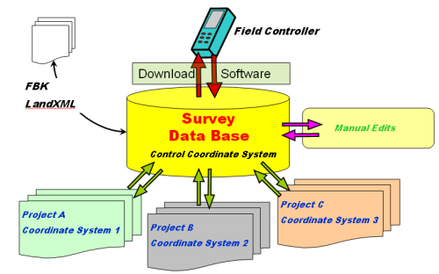
Survey Database:
TXT
.DWG Points
Notes:
Here we’ll see a simple example of a typical project scenario. With the Projects and Data Management solution that Civil 3D offers, a Vault server that can be installed on a network or local machine is where the “project” resides. We have multiple users using multiple drawings accessing and using data in the project.
We have user one who has referenced a surface from the project, and is working with it in a drawing on their machine. At the same time, we have a second user which is also referencing the same surface, but in this case is designing an alignment and profile from it. A third user is accessing the same data, but in this case, they are running an analysis on the surface. Note that these users can have read-write access to the data, allowing for a true multi-user system for sharing and managing our critical project information in real-time.

Slide 35
Demonstration
Process Field Data
Simulate Data Collection
Lines, Curves, Double Coding…

Slide 36
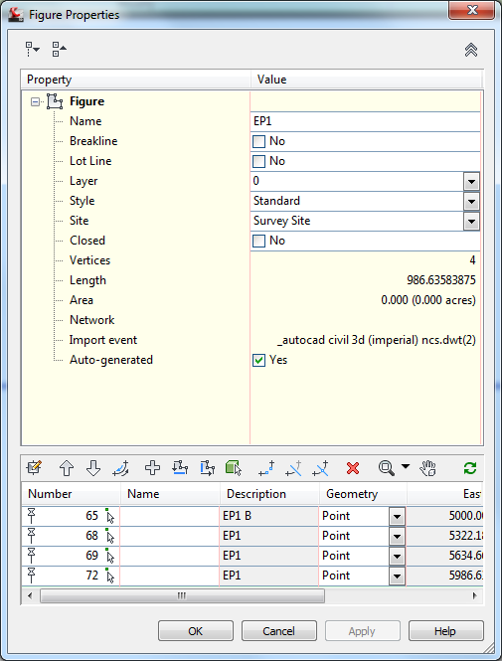
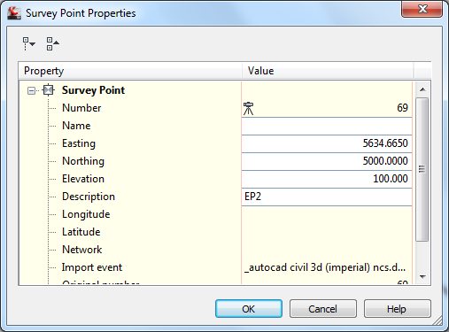
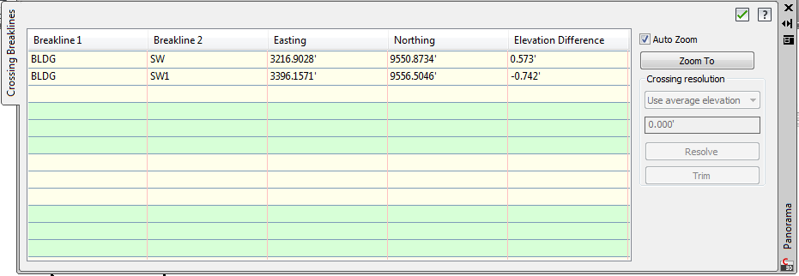
Editing Survey Figures:
Survey Point Properties
Survey Figure Properties
Resolve Crossing Breaklines

Slide 37
Demonstration
Survey Point Editing
Survey Figure Editing
Resolve Crossing Breaklines

Slide 38
Demonstration
Working With Notes
Survey Database Log
Survey Database Queries

Slide 39
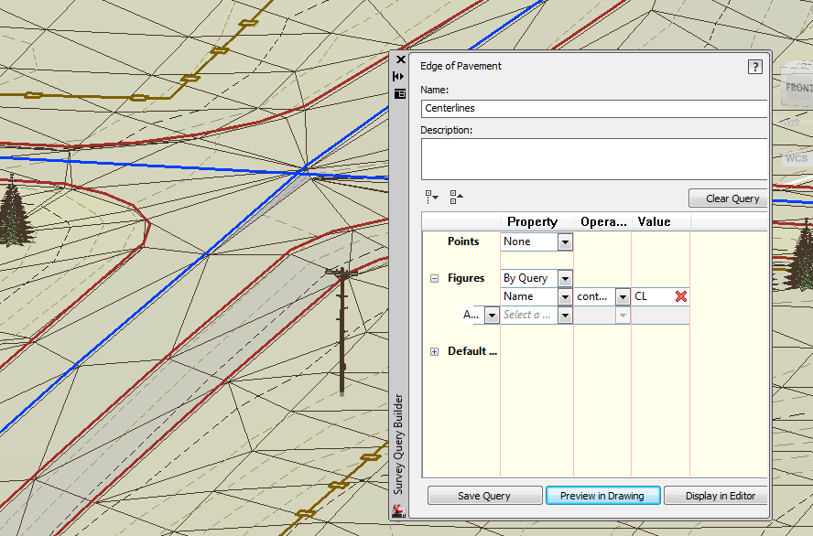
New Survey Query
Points and Figures
Dynamic Surface Creation

Slide 40
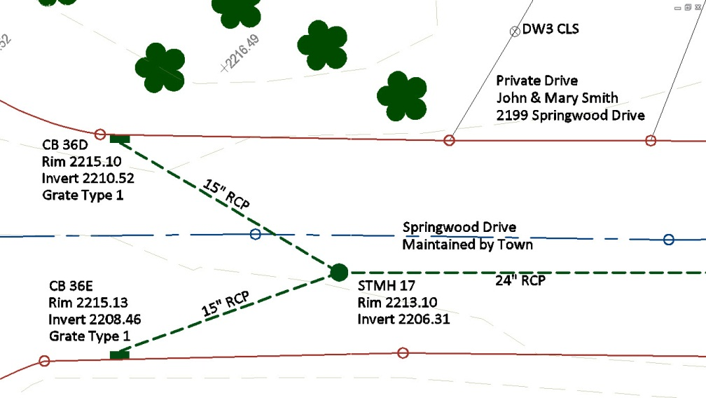
New Survey Tools
Access to Field-Collected
Survey Data
Import
Label
Query

Slide 41
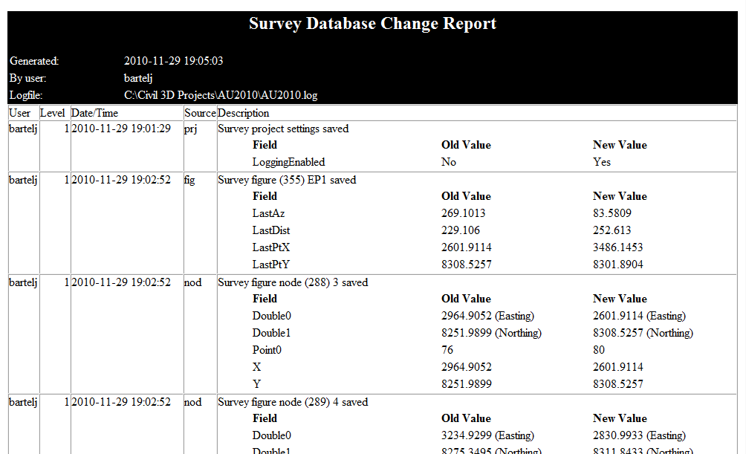
Bonus Information:
Working with “Notes”
Database Log

Slide 42
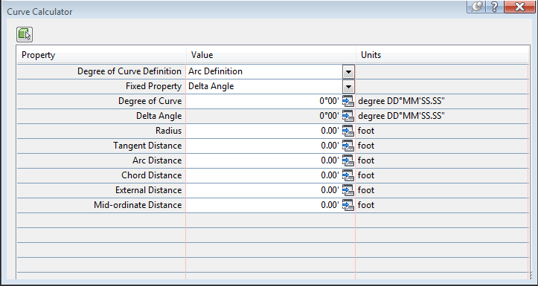
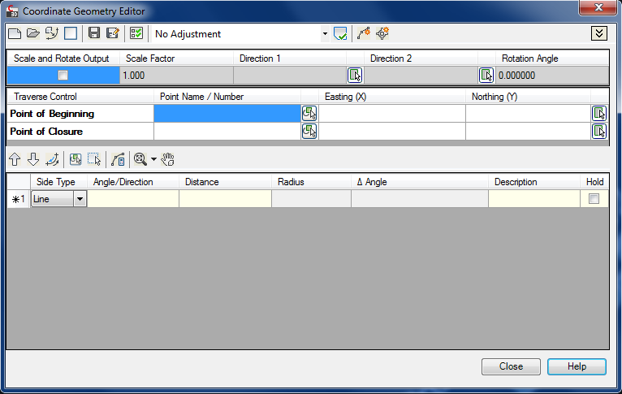
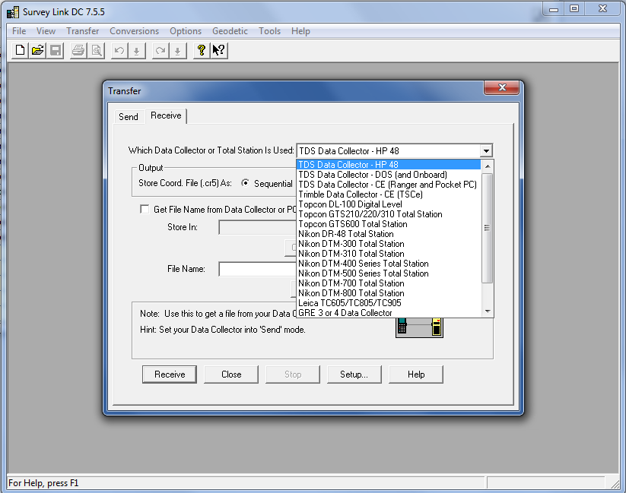
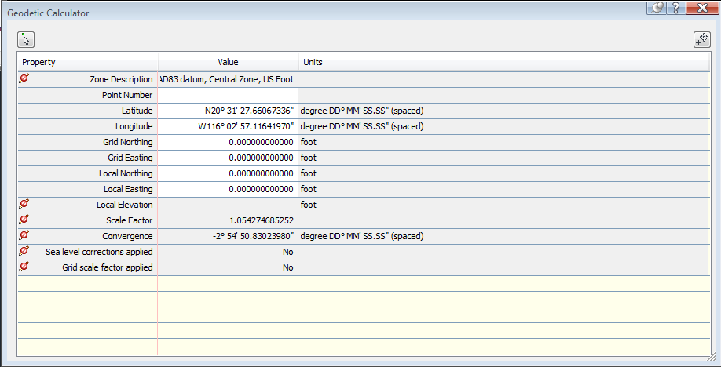
Mapcheck Tool / Curve Calculator
Survey Link DC / Geodetic Calculator / COGO Geometry Editor

Slide 43
Summary:
Learn the components and procedures required to collect linework in the field.
Witness a workflow that will work with any survey data collection equipment.
Learn how to quickly and easily edit survey figures
Understand the business benefits of collecting field data in a way that line work is created automatically.

Slide 44


Slide 45
Thank you!!
For further information contact us at:
ProSoft, Inc
sherring@prosoftnet.com
888.263.0393
www.prosoftnet.com
And remember to follow us at any of the below!!

